Slide 1
Annual Interagency Accessibility Forum
Accessibility: A Foundation for Inclusion, Diversity, and Equity
October 13, 2021
International Digital Accessibilities Activities
Panelists: Axel Leblois, Susanna Laurin, Dr. Yulia Sarviro

Slide 2



Panelists
Axel Leblois
Susanna Laurin
Yulia Sarviro
President and Executive Director
Global Initiative for Inclusive ICTs (G3ict)
Honorary Chair, Global Leadership Council and EU Representative
International Association of Accessibility Professionals (IAAP)
Senior Project Manager
Global Initiative for Inclusive ICTs (G3ict)

Slide 3

The DARE Index
Monitoring the Progress of Digital Accessiblity around the World A Research Conducted by Advocates for Advocates
IAAF Forum – 13 October 2021
Axel Leblois President & CEO
G3ict

Slide 4
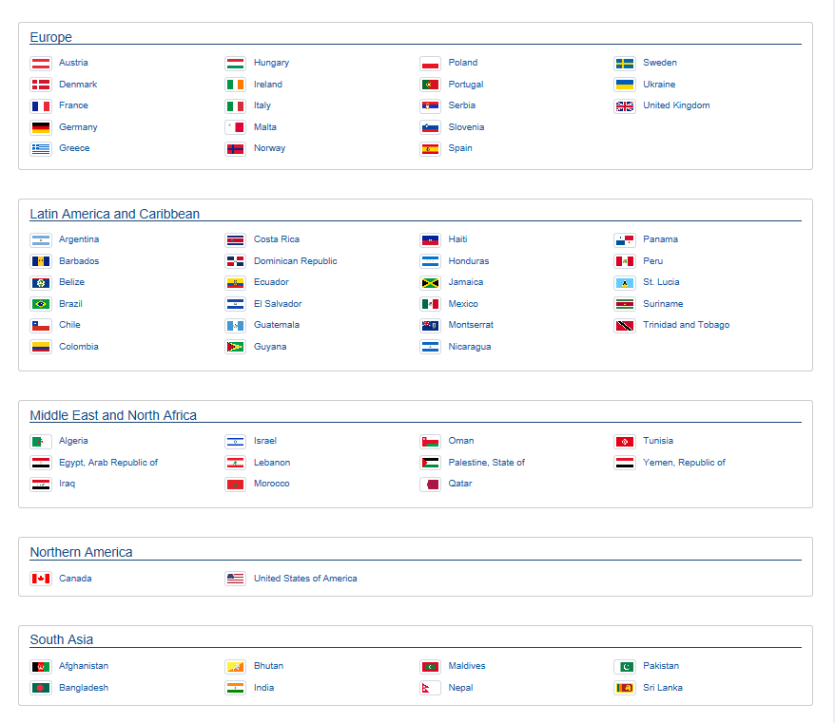
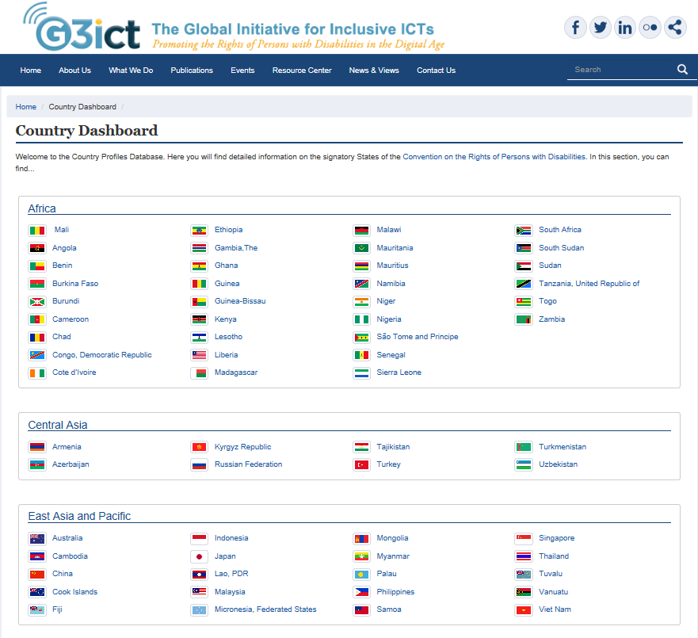
DARE Index Country Data: Provided by Research Panelists in 137 Countries; Dashboard Covers 91% of the World Population

Slide 5
The Big Picture – Global Results, All 137 Countries

Slide 6
Countries Commitments to Digital Accessibility Are Progressing
Country Commitments | % of Countries with Law/Regulation/Policy 2018 | % of Countries with Law/Regulation/Policy 2020
General Law Protecting the Rights of Persons with Disabilities | 83% | 89%
Reasonable Accommodation Defined | 64% | 68%
Legal Definition of Accessibility includes ICTs | 49% | 59%
Source: G3ict 2020 DARE Index – Comparison of the 101 countries surveyed in both years

Slide 7
Gaps in Capacity to Implement Are the Biggest Obstacle to Progress
COUNTRIES CAPACITY TO IMPLEMENT VARIABLES | GLOBAL AVERAGE OF COUNTRIES’ CAPACITY TO IMPLEMENT
Government Agency for Persons with Disabilities | 88%
Country Refers to International ICT Accessibility Standards | 44%
Government Entity for Accessible ICTs | 39%
ICT Accessibility Courses are Available at Major Universities or Offered By Professional Educational Services | 38%
Process to Involve Persons with Disabilities in ICT Accessibility Policy Making | 26%
Country Capacity to Implement Global Progress Average in Percentage | 46%

Slide 8
Lack of Processes to Involve Persons with Disabilities in Policy Making on ICT Accessibility as per Art. 4.3 of the CRPD
Source: G3ict 2020 DARE Index, 137 Countries surveyed

Slide 9
Global Progress of Sectorial Policies and Programs
TV 61%
Web 58%
Inclusive ICTs in education 54%
E-books 51%
E-government and Smart Cities 50%
Promoting Internet Availability and Usage 49%
Enabling ICTs for Employment 47%
Public Procurement 46%
ATs and ICTs for independent living 39%
Mobile 38%
% of Countries with a Policy with Implementation in Process

Slide 10
However, Current Levels of Implementation Remain Very Low
Global Average Levels for TV, Web and e-Government and Smart Cities
Levels of ICT Accessibility Implementation and Outcomes | No policy | No implemen-tation | Minimum | Partial | Substantial | Full
Web Accessibility | 42% | 4% | 20% | 30% | 4% | 1%
E-government and Smart Cities Accessibility | 50% | 4% | 23% | 18% | 4% | 0%
Public Procurement | 54% | 4% | 24% | 16% | 2% | 0%
Source: G3ict 2020 DARE Index – 137 Countries

Slide 11
Public Procurement – Observations
EU and OECD countries are on the path to adopt the EN standard.
Among emerging economies, countries such as India and Kenya are in the process of adapting those to their local conditions, mostly for language issues.
A large number of countries that indicate the presence of a public procurement policy refer to sectoral initiatives such as rules for the procurement of web developments and services or for Education applications.
Main challenge around the world is capacity to implement those policies and building the skills required for implementation.

Slide 12
G3ict DARE Academy – In Cooperation with Leading Global Disability Organizations
Scholarship Fund – Aimed at Promoting the IAAP Professional Certification among Persons with Disabilities Involved in Advocacy activities. First scholarships awarded in September 2021.
Webinar Series on Accessiblity Policies and Programs for Leaders of Advocacy Organizations and Policy Makers.
Global Network of Digital Accessibility Champions.

Slide 13

Thank you for Your Attention!
www.g3ict.org smartcities4all.org
www.accessibilityassociation.org

Slide 14
Update: EU Accessibility Legislation
susanna.laurin@funka.com

Slide 15
Digital Accessibility in the EU
UNCRPD
Disability Strategy
Procurement Directive
Web Accessibility Directive
European Accessibility Act

Slide 16

Web Accessibility Directive

Slide 17

Suddenly, things move fast
2016 Decison
2018 Application
2019 New websites
2020 All websites
2021 Apps
2021 Monitoring and reporting
2021 Review started
2022 Results presented

Slide 18

WAD Review
Evaluation of progress
Public and targeted consultations
Analysis of member states reports
Mapping of technological advances
Recommendations

Slide 19

Evaluation Criteria
Efficiency
Effectiveness
Relevance
Coherence
EU added value

Slide 20
European Accessibility Act

Slide 21

Ongoing preparations
2019 Decision
2021 Investigation
2022 National legislation
2025 Application
2027 Possible exceptions
2030 Ongoing service contracts

Slide 22

Still to be determined
Monitoring agencies
Minimum requirements
Implementation Acts

Slide 23

Scope and Impact
Public sector
Publicly funded institutions
ICT suppliers
Products
Computers and smart phones
Self servide terminals
Digital TV and streaming services
E-books and e-readers
Services
Emergency services
Transportation (digital services)
E-commerce
Consumer banking

Slide 24

Harmonization – with room for innovation

Slide 25
There is no such thing as an average user
susanna.laurin@funka.com

